Slide 1

The Reproducibility of Economics Research: A Case Study
BITSS Annual Meeting 2018, Berkeley December 10, 2018
Hautahi Kingi IMPAQ International
Lars Vilhuber
Cornell, American Economic Association
Sylverie Herbert
Cornell
Flavio Stanchi
Cornell

Slide 2
Background

Slide 3
Increasing transparency in economics journals
Econometrica
“ the original raw data will, as a rule, be published, unless their volume is excessive”
1933

Slide 4
Increasing transparency in economics journals
Journal of Political Economy
“ Confirmations and Contradictions” Section
1976-1999

Slide 5
Increasing transparency in economics journals
Journal of Money, Credit & Banking
Data and Code requested upon submission
1982

Slide 6
Increasing transparency in economics journals
American Economic Association
Data and code availability policies
2005

Slide 7
Increasing transparency in economics journals
Quarterly Journal of Economics
Data and code availability policies
2016

Slide 8
“Authors of accepted papers … must provide to the Review, prior to publication, the data, programs, and other details of the computations sufficient to permit replication. … The Editor should be notified at the time of submission if the data used in a paper are proprietary or if, for some other reason, the requirements above cannot be met.”
- AEA Data Policy

Slide 9
How common is replication in economics?
0.1% of 126,505 “top 50” published articles 1974-2014 – Mueller-Langer et al. (2018)

Slide 10
How common is replication in economics?
0.1% of 126,505 “top 50” published articles 1974-2014 – Mueller-Langer et al. (2018)
6.2% of 1,138 “top 10” empirical development articles 2000-2015 - Sukhtankar (2017)

Slide 11
How common is replication in economics?
0.1% of 126,505 “top 50” published articles 1974-2014 – Mueller-Langer et al. (2018)
6.2% of 1,138 “top 10” empirical development articles 2000-2015 - Sukhtankar (2017)
16 journals have published > 3 replications - Duvendack et al. (2017)

Slide 12
How common is replication in economics?
0.1% of 126,505 “top 50” published articles 1974-2014 – Mueller-Langer et al. (2018)
6.2% of 1,138 “top 10” empirical development articles 2000-2015 - Sukhtankar (2017)
16 journals have published > 3 replications - Duvendack et al. (2017)
But some disagree - Hamermesh (2017)

Slide 13
Replication in economics is “usually not successful”
+
13%
Dewald, Thursby & Anderson (1986)

Slide 14
Replication in economics is “usually not successful”
+
+
13%
6%
Dewald, Thursby & Anderson (1986)
McCullough et al. (2006)

Slide 15
Replication in economics is “usually not successful”
+
+
+
13%
6%
43%
Dewald, Thursby & Anderson (1986)
McCullough et al. (2006)
Chang & Li (2015)

Slide 16
Replication in economics is “usually not successful”
+
+
+
13%
6%
43%
Dewald, Thursby & Anderson (1986)
McCullough et al. (2006)
Chang & Li (2015)
+
61%
Camerer et al. (2016)

Slide 17
Replication continuum (Bollen et al. 2015)

Slide 18
Replication continuum (Bollen et al. 2015)
08
Reproducibility
Narrow Replication (Pesaran 2003)
Pure Replication (Hamermesh 2007)
Verification (Clemens 2015)

Slide 19
Replication continuum (Bollen et al. 2015)
08
08
Reproducibility
Replicability
Narrow Replication (Pesaran 2003)
Pure Replication (Hamermesh 2007)
Verification (Clemens 2015)
Wide Replication (Pesaran 2003)
Statistical Replication (Hamermesh 2007)
Reproduction/Reanalysis (Clemens 2015)

Slide 20
Replication continuum (Bollen et al. 2015)
08
08
08
Reproducibility
Replicability
Generalizability
Narrow Replication (Pesaran 2003)
Pure Replication (Hamermesh 2007)
Verification (Clemens 2015)
Wide Replication (Pesaran 2003)
Statistical Replication (Hamermesh 2007)
Reproduction/Reanalysis (Clemens 2015)
Wider Replication (Pesaran 2003)
Scientific Replication (Hamermesh 2007)
Reanalysis/Robustness (Clemens 2015)

Slide 21
Replication continuum (Bollen et al. 2015)
Our Focus
08
Reproducibility
Replicability
Generalizability
Narrow Replication (Pesaran 2003)
Pure Replication (Hamermesh 2007)
Verification (Clemens 2015)
Wide Replication (Pesaran 2003)
Statistical Replication (Hamermesh 2007)
Reproduction/Reanalysis (Clemens 2015)
Wider Replication (Pesaran 2003)
Scientific Replication (Hamermesh 2007)
Reanalysis/Robustness (Clemens 2015)

Slide 22
“We believe this basic standard should be expected of all published economics research, and hope this expectation is universal among researchers.”
- Christensen & Miguel (2018, JEL)

Slide 23
Method

Slide 24

Undergraduate Summer Research Assistants
2014 - 2018

Slide 25
Undergraduate Summer Research Assistants
2014 - 2018
Economics
Comp Sci.
OpRe

Slide 26
Undergraduate Summer Research Assistants
2014 - 2018
Economics
Comp Sci.
OpRe
Reproduction
VCS
Cloud Computing

Slide 27

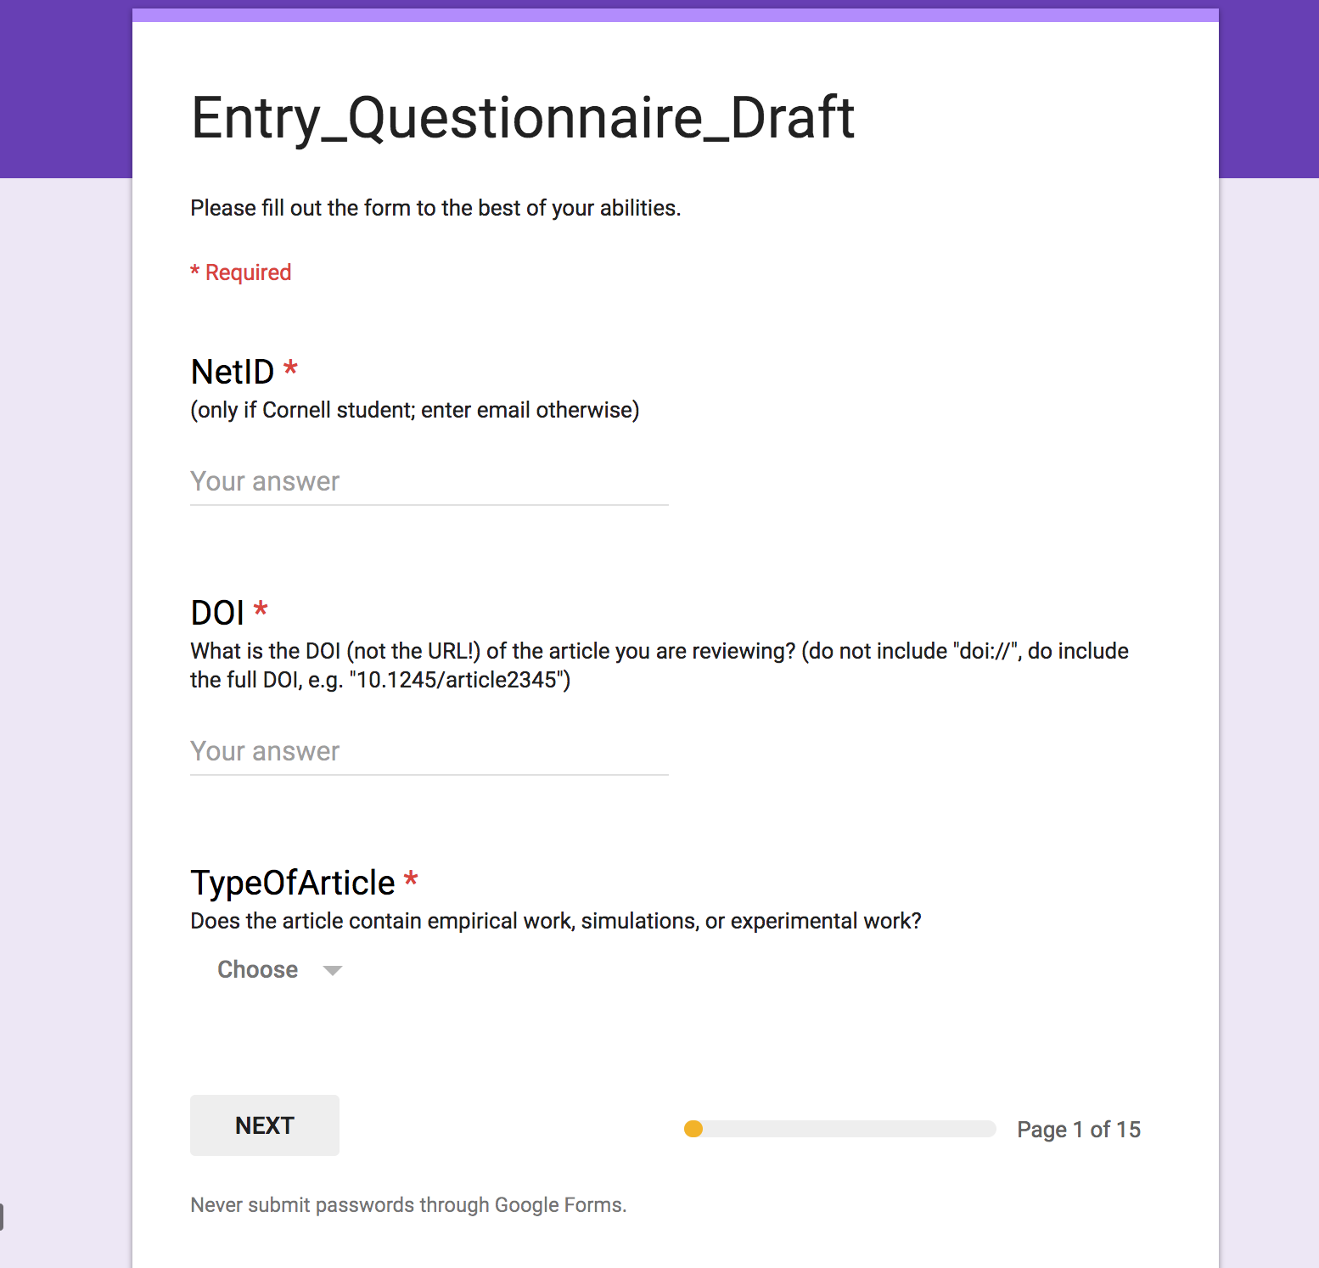
Method
Assessment Form

Slide 28

Method
Assessment Form
Reproduction Exercise

Slide 29


Method
Assessment Form
Reproduction Exercise
Exit Questionnaire

Slide 30
Article Descriptions

Slide 31
303 articles examined

Slide 32
Uniform distribution of difficulty

Slide 33
Uniform distribution of difficulty
Data provided & public
Documentation clear & complete
Code ready to run

Slide 34
Uniform distribution of difficulty
Documentation unclear
Code order ambiguous

Slide 35
Uniform distribution of difficulty
Missing Data/Code/Documentation

Slide 36

Stata dominates

Slide 37
Documentation quality is decent

Slide 38
Documentation quality is decent
Missing/Incomplete/Ambiguous ReadMe file

Slide 39
Documentation quality is decent
ReadMe file with step-by-step instructions

Slide 40
Results

Slide 41
Moderate replication success
25% total success rate
33% confidential data
43% successful conditional on available data
42% partial conditional on available data

Slide 42
Multiple reasons for
unsuccessful reproduction
Year | Missing Data | Corrupted Data | Code Error | Software Unavailable | Other
2009 |  | 1
2010 |  |  |  |  | 3
2011
2012 | 1 | 1 | 1 |  | 12
2013
2014 | 1 |  |  | 1
2015
2016 | 1
2017 | 1 |  |  |  | 1
2018 |  | 1

Slide 43
1/3 of successful reproductions required complex code moderations

Slide 44
Documentation quality is positively associated with reproductive success
OLS
Confirming Findings/Suspicions of:
Chang & Li (2015)
McCullough et al. (2006)
Stark (2018)
 | Binary (1 = Successful Reproduction)
Documentation Quality | 0.300*** (0.080)
Constant | 0.200*** (0.070)

Slide 45
Positive but noisy citation bonus for using confidential data
 | Annual Citations
Avg h-index | 3.00***
Top h-index |  | 1.00***
Low h-index |  |  | 2.00
Confidential Data | 17.00*** | 13.00* | 8.00
OLS
High past citations indicate high future citations
No interaction effect (not shown)

Slide 46
Reproducibility doesn’t affect citations
 | Log Annual Citations
Avg h-index | 0.20*** |  |  | 0.20***
Top h-index |  | 0.07*** |  |  | 0.07**
Low h-index |  |  | 0.10** |  |  | 0.09
Successful Reproduction | .70* | 0.50 | 0.50
Successful/Partial Reproduction |  |  |  | 0.40 | 0.10 | -0.10

Slide 47
Recap
American Economic Journal: Applied Economics
”only if the data used in the analysis are clearly and precisely documented and are readily available to any researcher for purposes of replication”
Reproduction:
25% Success
43% Success (conditional on data)

Slide 48
Thanks

